Slide 1
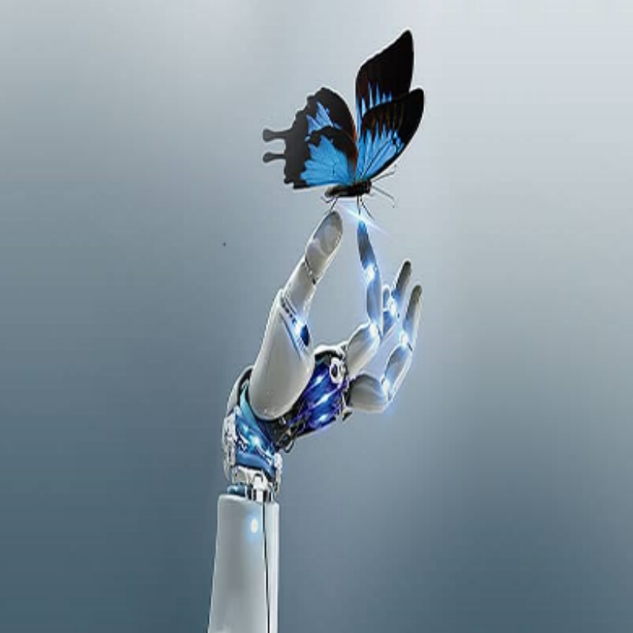
International workshop on
Machine Learning & Python
20-22 December 2019
Sousse
General Chairs
Through this international workshop you will discover how to build Machine Learning (ML) models and accelerated computing applications. Training sessions will be comprised of brief overviews ML fondations and hands-on programming sessions with SciKit-Learn and Tensorflow python libraries that will expose you to the bleeding edge of learning and artificial intelligence. You will explore several applications.
The training is provided by a certified as a Huawei Instructor in Artificial Intelligence: Dr. Bassem BEN HAMED (ENET'Com, Sfax University).
All participants are encouraged to present a poster and obtain feedback from their peers and colleagues in the field. Awards will be given to the best 3 posters. A free spirit discussion and collaboration session is also planned to enhance the collaboration opportunities between the workshop participants and organizers.
Pr. Moncef ELGAFSI (U. C.)
Pr. Souad CHCHABI (LATIS. Lab)
Dr. Ali KHALFALLAH (SETIT R. U.)
Scientific Chairs
Pr. Mounir SAYADI (SIME Lab)
Pr. Naoufel KRAIEM (U. C.)
Organisation Chairs
Dr. Hédi AMRI (SETIT R. U.)
SENTIDO Rosa Beach ****
The number of places is LIMITED
Workshop Program
Friday, 20th December 2019
10:00: Registration.
12:30: Lunch
14:00: Opening ceremony
14:30: Introduction to Machine Learning
15:00: Overview on Python
15:00: Numpy, Pandas and Matplotlib Libraries
16:00: Coffee break
16:30: Non supervised learning with K-Means and Hierarchical
Clustering
18:00: Poster Session
19:30: Dinner
Sunday, 22th December 2019
09:00: Artificial Neural Network & Convolution Neural Network
11:00: Coffee break
11:30: Deep Learning and Transfer Learning
13:00: Closing ceremony
Participation Fees
From 20th to 22th December 2019
For Doctors, researchers enrolled in Thesis :
500 Dinars in a half double room
600 Dinars in a single room
For Academics and Teachers
650 Dinars in a half double room
750 Dinars in a single room
For industrialists
750 Dinars in a half double room
850 Dinars in a single room
A financial support may be granted to participants not supported by their research structures
Saturday, 21th December 2019
09:00: Installation of Python and Machine Learning libraries
11:00: Coffee break
11:30: Installation of Deep Learning Libraries
12:30: Lunch
14:00: Supervised Learning with Multiple Linear Regression
and Features Selection
16:00: Coffee break
16:30: Supervised Learning with Classification algorithms
(KNN, SVM, Random Forest, …) and performance
(ROC and CAP curves)
18:00: Poster Session
19:30: Dinner
setit.events@isbs.usf.tn
www.setit.rnu.tn/ML2019

